Slide 1

LAPTOP PRICE PREDICTION

Slide 2
About me
Name: K Tarun
Degree: Bachelor of Technology
College : TKR College of Engineering & Technology (Electronics and communication Engineering)

Slide 3
Business Problem and Use case domain understanding
E-Commerce Pricing strategy
Business Problem: An E-commerce company wants to optimize its laptop pricing to strategy to maximize revenue and stay competitive in the market
Use case: Predicting laptop prices based on various features and market dynamics to set competitive and profitable prices points for different laptop models
Objective of the Project
Laptop Price Prediction, Analyzing the data from e-commerce website through Web Scrapping. This Project Combines data collection, data, preprocessing, web scrapping.
Data collection:
Implementing web scrapping techniques to collect data from e-commerce websites that list laptop specifications and prices. Extract information such as brand, model, processor, RAM, Storage, screen size and price.
Data Preprocessing:
Clean and preprocess the scraped data to ensure consistency and quality. Handle missing value, remove duplicates, and convert data into a structure format suitable for machine Learning.

Slide 4

Website
Flipkart is an Indian e-commerce company, head quartered in Bangalore
Flipkart is Founded in Year 2007 by Binny Bansal & Sachin Bansal
Flipkart is an online market place where users can purchase a wide range of products, including electronics, fashion, books, home appliances and more
This Photo by Unknown Author is licensed under CC BY-NC-ND

Slide 5
Web Scraping – Details
Web scrapping using BeautifulSoup, which is a python library for extracting data from HTML and XML documents. It is commonly used for extracting data from webpages
>>Importing the necessary libraries
From bs4 import BeautifulSoup
Import requests
Use the request library to send a GET to the URL you want to scrape
base_url='https://www.flipkart.com/search?q=laptops&otracker=search&otracker1=search&marketplace=FLIPKART&as-show=off&as=off&page=‘
Parse the HTML content of the webpage using BeautifulSoup. You can specify the parser you want to use
Response = requests.get(url)
Soup = BeautifulSoup(response, ‘html.parser’)
Navigate the parsed HTML and extract the data you need. This often involves identifying HTML elements using their classes, tags and attributes.

Slide 6
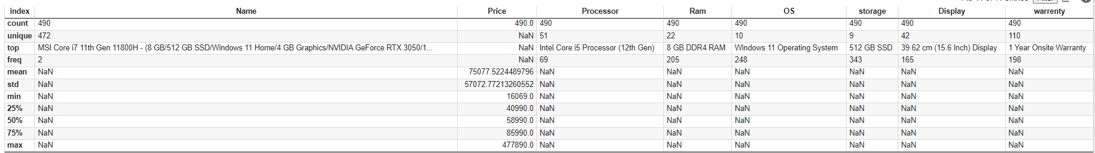
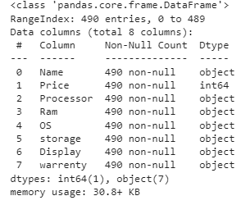
Summary of the Data

Slide 7
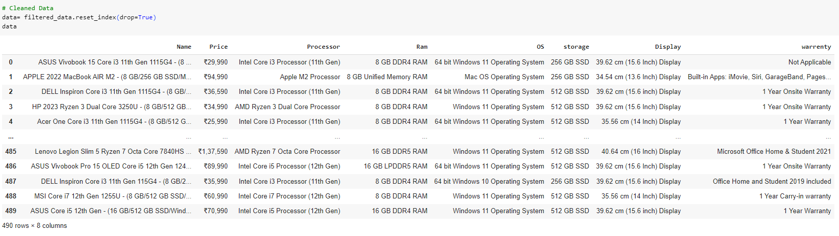
Data Cleaning
Clean and Preprocess the data scraped data to ensure consistency and quality. Handle missing values, remove duplicates, and convert data into a structured format suitable for machine learning
Importing Necessary Libraries
import pandas as pd
import numpy as np
import re
import matplotlib.pyplot as plt
import seaborn as sns
import requests
from bs4 import BeautifulSoup
import csv

Slide 8

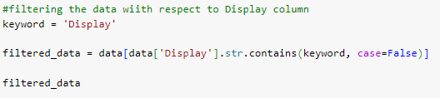
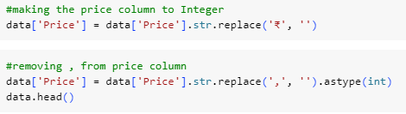
Data Manipulation
Data manipulation is process of changing, cleaning, and organizing data to make it more suitable for analysis, reporting, or other data related tasks. It involves various operations on data including filtering, sorting, aggregating, transforming, and combining data.

Slide 9
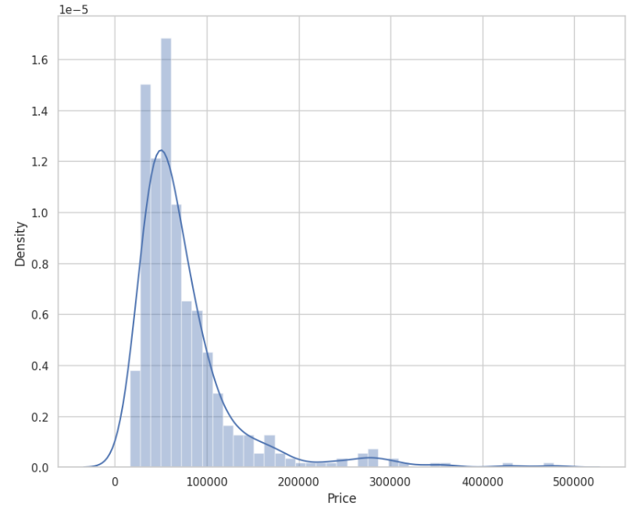
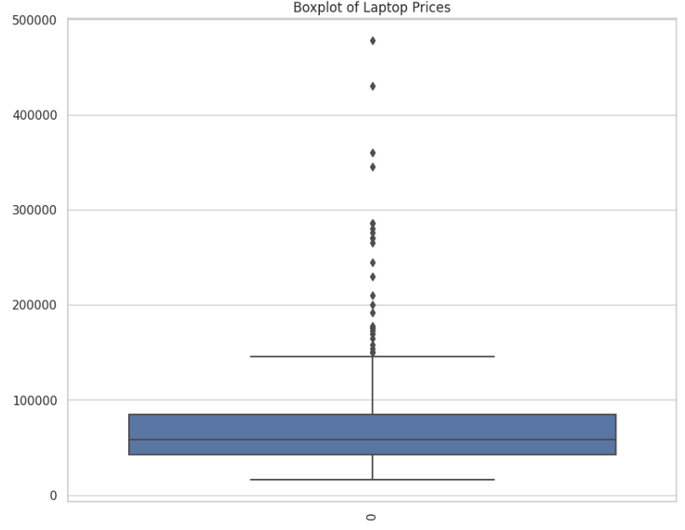
Data Visualisations

Slide 10
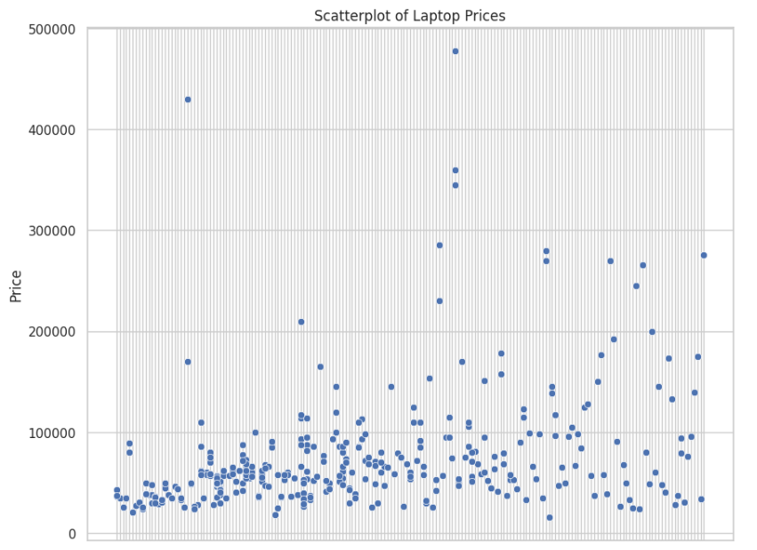
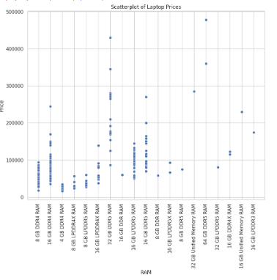

Slide 11
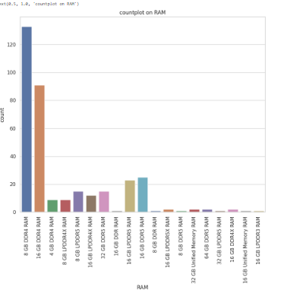
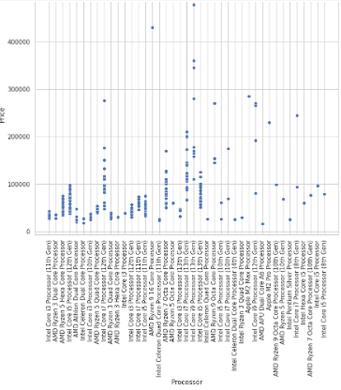
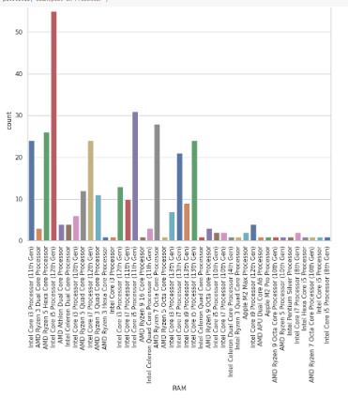

Slide 12
Experience
Data collection/ Data Acquisition
Exposure to real time data
Web scrapping
Challenges
Data Quality
Data cleaning
Data manipulation
Time consumption
Robustness

Slide 13

This Photo by Unknown Author is licensed under CC BY-SA-NC

Slide 14

THANK YOU

